Slide 1
Professor
Jorge Alfonso Meléndez Acuña

Slide 2
Welcome

Slide 3
Schedule
Network Science for Data Analytics
Unit 1
Introduction to Network Analysis
Unit 2
Centrality
Measures
Unit 3
Introduction to Network Models
Unit 4
Community Detection
Unit 5
Error and Attack Tolerance
Unit 6
Graph Machine Learning
Introduction to
Data Science
Basic Concepts of Graph Theory
Hubs
Communities
Vulnerability in networks
Machine Learning with Graphs
Introduction to Network Science
Small Worlds
Network Models
Deep Learning with Graphs

Slide 4
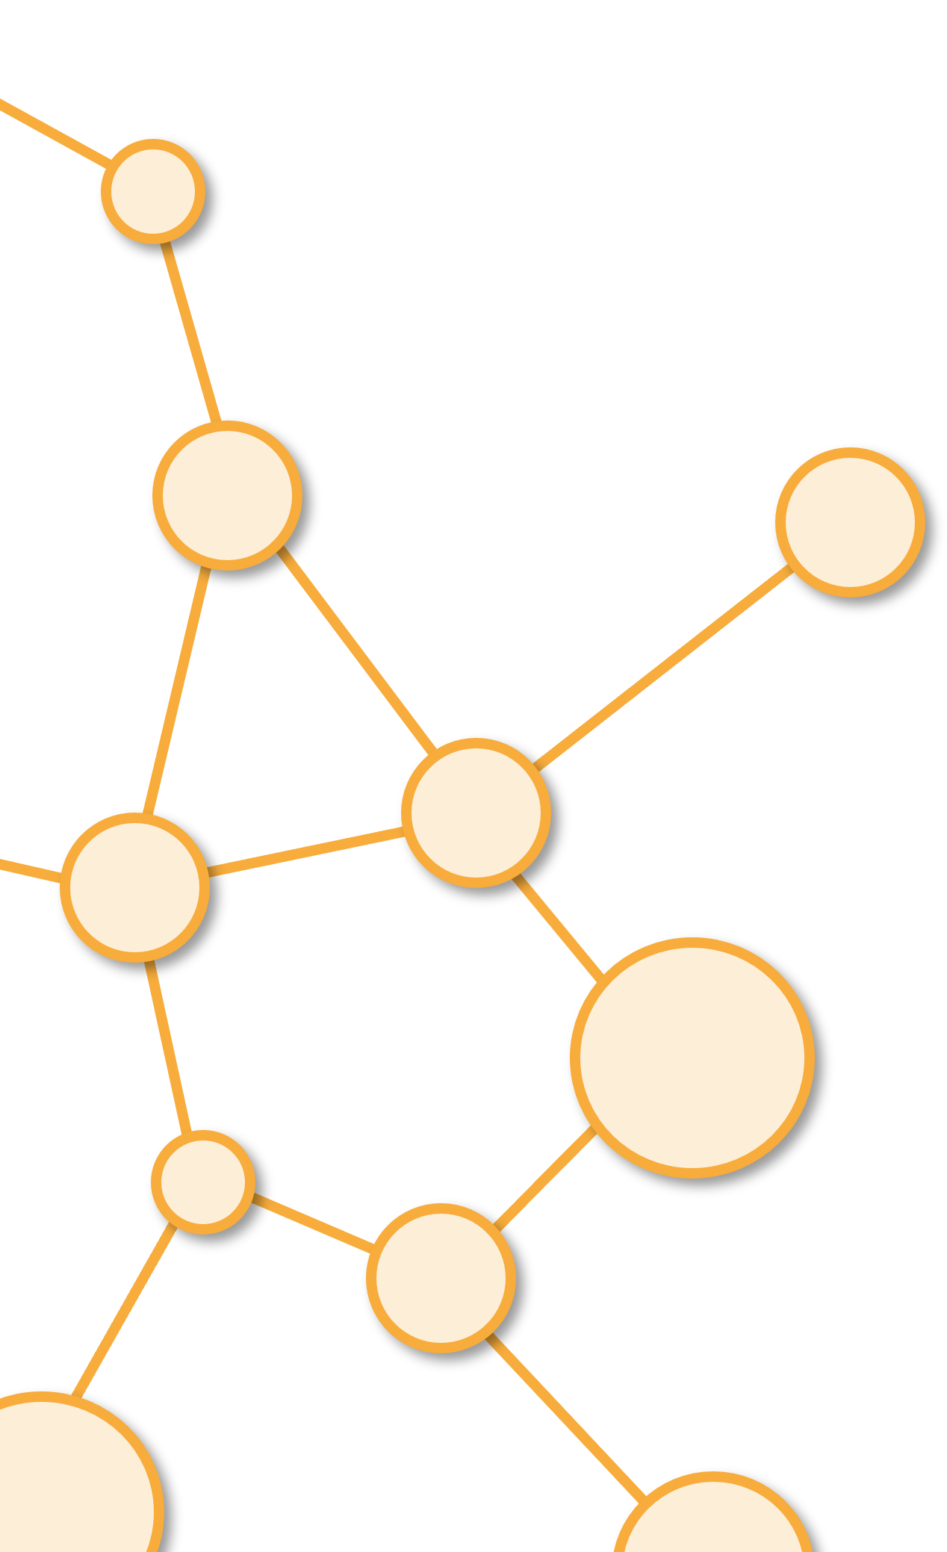
Homophily and Assortativity
Unit 4

Slide 5
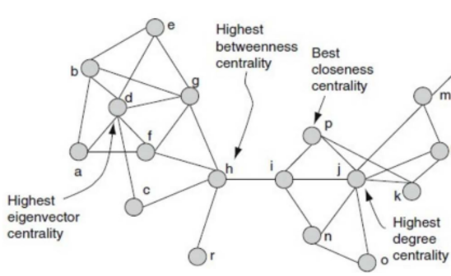
Local

Slide 6
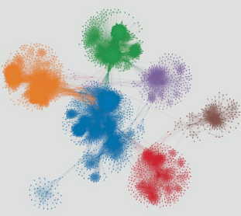
Meso

Slide 7
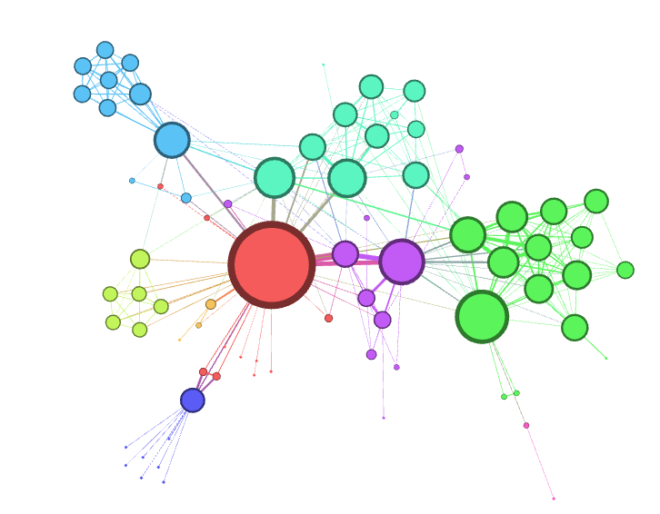
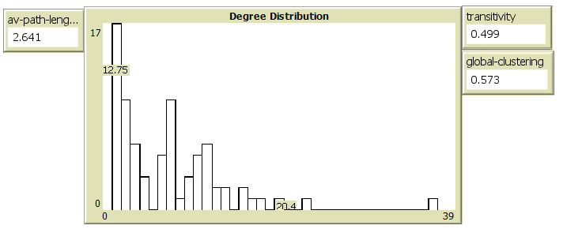
Global

Slide 8
Meso-Scale
Analysis Between Local and Global
Global Analysis: A number describes the networkred (density,APL)
Local Analysis: A number for each node: (degree, betweenness)
Meso-Scale: Groups of Nodes
¿Relation between nodes?
¿Neighborhood of nodes in a group?
Most Popular meso Analysis: Community Discovery

Slide 9
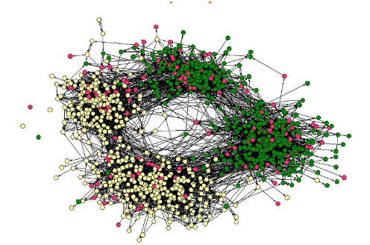
Homophily

Slide 10
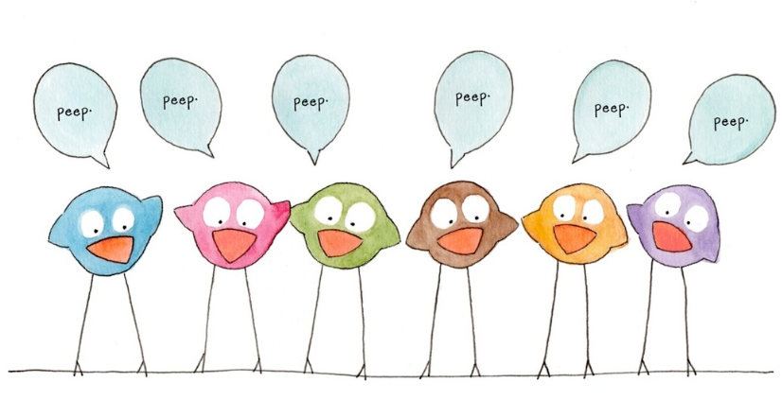
Homophily
“love of like” “Birds of a feather flock together”
People will tend to associate with people with similar characteristics as their own .
Many factors influence and favor homophily, and they are not necessarily exclusively explained by individual preference.
sometimes homophily is a property emerging from access.
()
In other words, homophily
is not only the result of our preferences, but also of social constructs

Slide 11
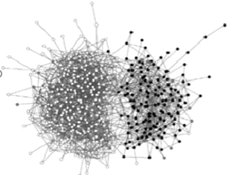
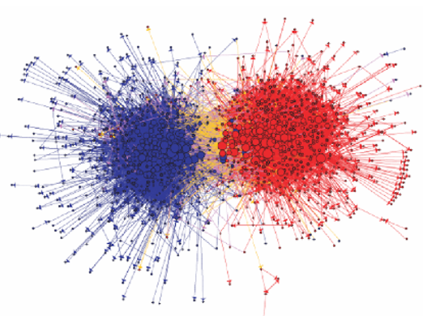
Homophily and Communities
When there is strong Homophily (Assortativity) There are Communities

Slide 12
Examples of Homophily

Slide 13
Carrousel of Examples

Slide 14


School and Marriage
School children are more likely to make friends with people sharing their gender or race
In marriage ties, it is so overwhelmingly likely to date or marry someone of the same race that sociologists don’t study this fact any more

Slide 15
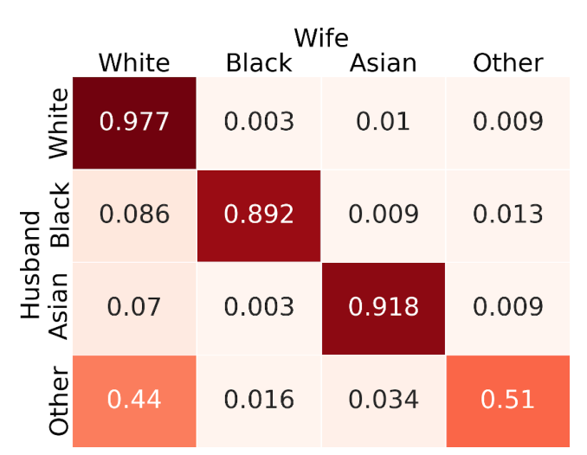
Marriages

Slide 16
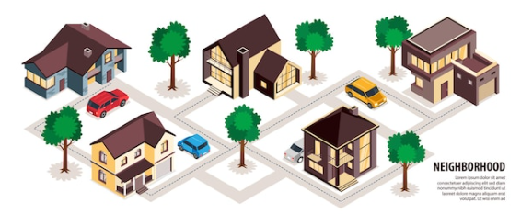
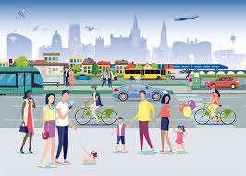
Spatial Homophily
living in the same place makes it easier to have stronger connections, a factor that overcomes other correlates such as race
mobility homophily:
going to the same places influences the likelihood of connecting socially

Slide 17

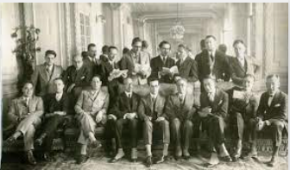
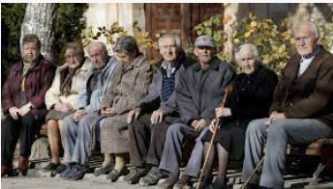
Temporal Homophily
Being in the same age range favors connections
38% of a person’s friends are within a 2-year age gap

Slide 18
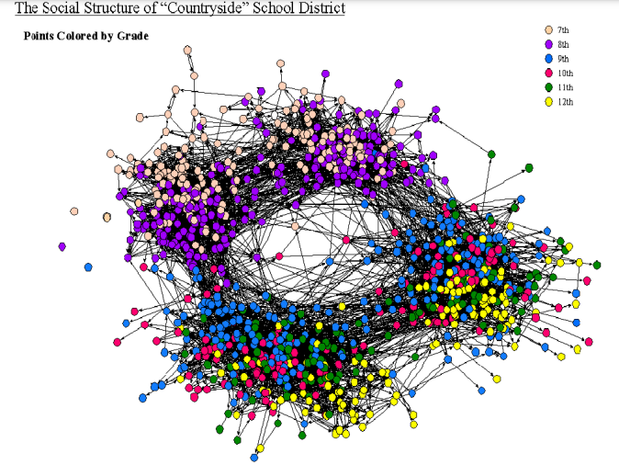
Homophily by Grade

Slide 19
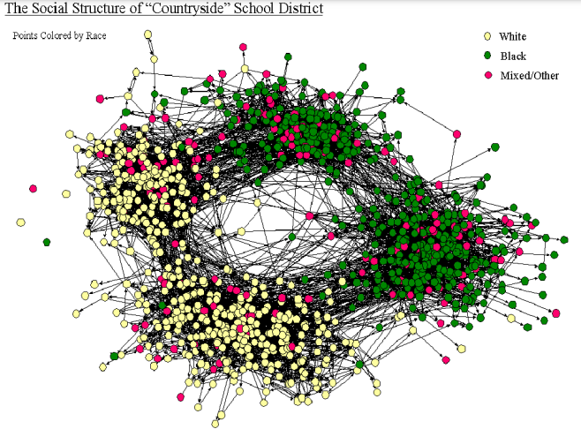
Homophily by Race

Slide 20
Real Networks

Slide 21
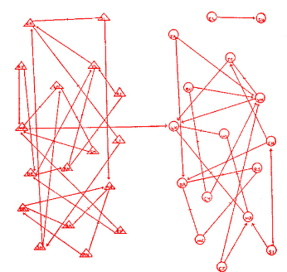
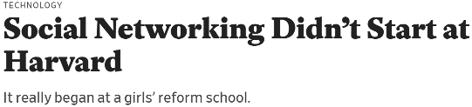
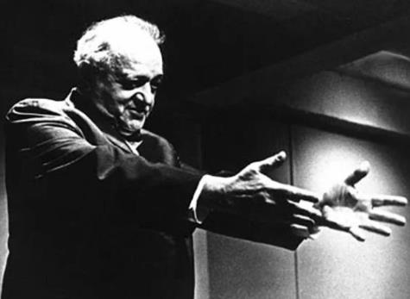

School PlayYard
Link to Model

Slide 22

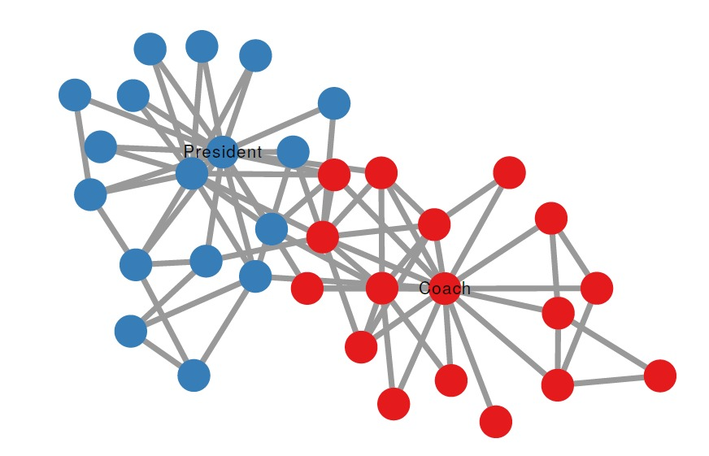
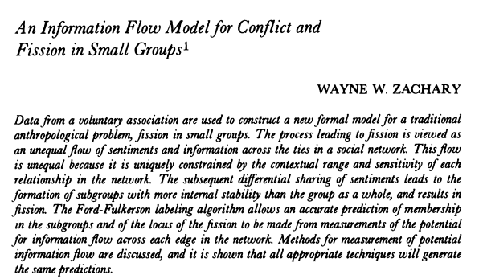
Karate Network
Link to Model

Slide 23
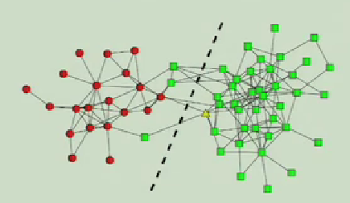
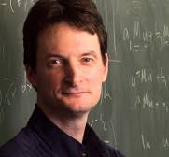
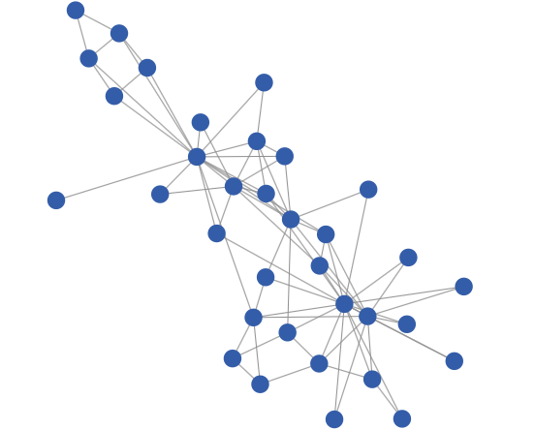
Animal Network
A lost Dolphin
Mark
Newman
Link to Model
Dolphin Network

Slide 24
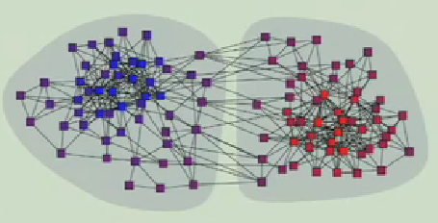
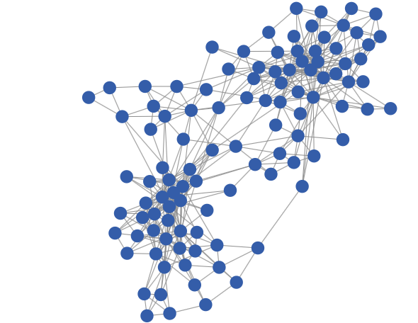
Amazon Books
¿Which pair of books are bought together in Amazon?
Red and Blue Books
Link to Model

Slide 25
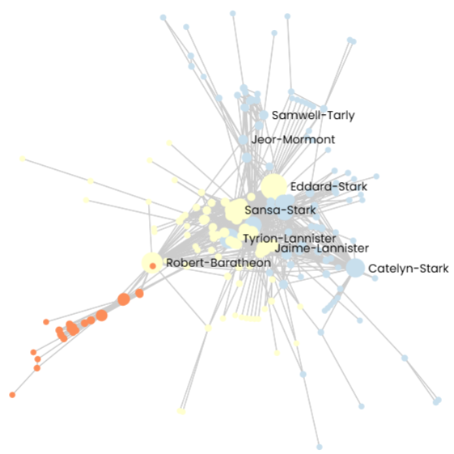
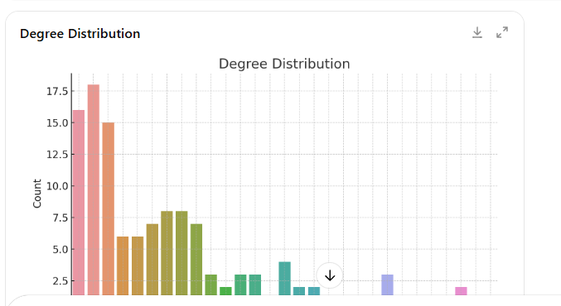
Game of Thrones
Link to Model

Slide 26
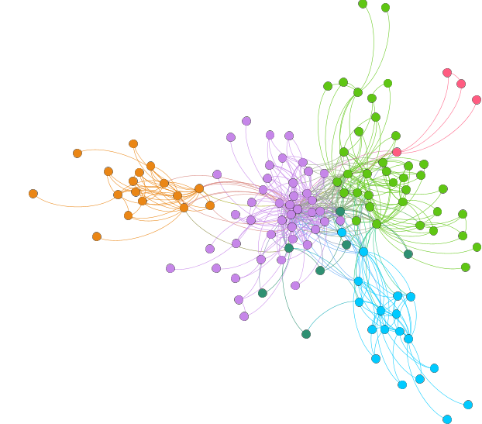
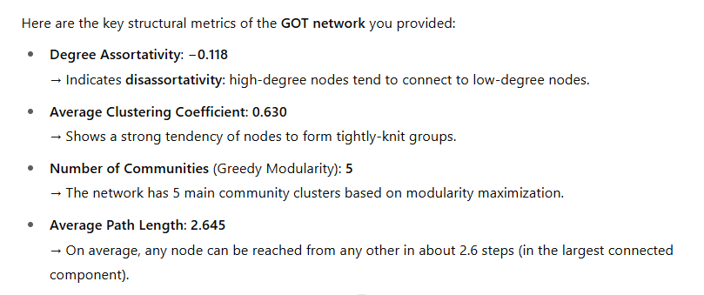
Game of Thrones
Link to Model

Slide 27
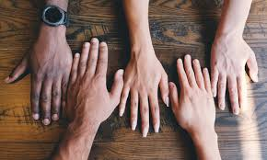
The Dark side of Homophily

Slide 28
Dark side
The dark side of homophily refers to the negative social, informational, and structural consequences that arise when individuals or groups preferentially connect with others who are similar to themselves. While homophily ("birds of a feather flock together") can foster trust and cohesion, it also has serious downsides in both human and algorithmic systems.

Slide 29


Dark side
1. Echo Chambers and Filter Bubbles
In social networks (online and offline), homophily can lead to echo chambers, where people are only exposed to opinions and information that reinforce their existing beliefs.
This limits exposure to diverse perspectives, contributing to polarization and intolerance.

Slide 30
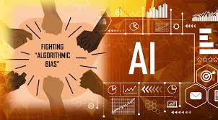

Dark side
3. Algorithmic Bias
Recommender systems and AI trained on homophilic data (e.g., “people like you watched...”) can reinforce biases and segregation.
Platforms may unintentionally amplify discrimination by learning and reinforcing homophilous patterns.

Slide 31
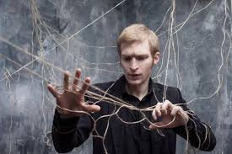

Dark side
4. Innovation Suppression
Diverse teams often outperform homogeneous ones in problem solving and creativity.
Homophily in social and professional networks can lead to redundant ideas, groupthink, and limited innovation.

Slide 32


Dark side
5. Barriers to Social Mobility
In educational or workplace settings, homophily can prevent cross-group interaction, limiting the flow of information, opportunities, and resources to disadvantaged groups.

Slide 33
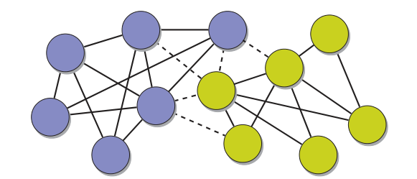
Assortativity

Slide 34
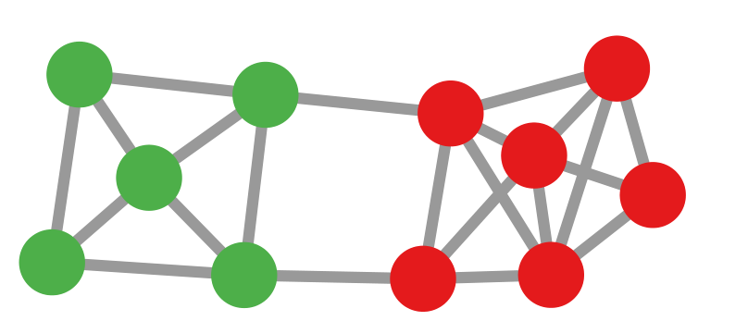
What is?
Assortativity is a measure of the tendency of nodes in a network to connect to other nodes that are similar to themselves in some way.

Slide 35
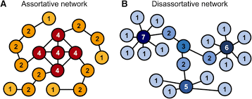
Types of Assortativity
Assortativity by Degree (numerical)
Measures whether high-degree nodes tend to connect to other high-degree nodes.
Common in social networks (e.g., celebrities following celebrities).
Measured using the Pearson correlation of the degrees at both ends of each edge.

Slide 36
What is?
Types of Assortativity
Assortativity by Attribute (categorical)
Measures whether nodes with the same category (e.g., gender, race, profession) tend to connect.
For example, in a school friendship network, are boys more likely to be friends with boys?
Computed using a modularity-like formula over node labels.

Slide 37
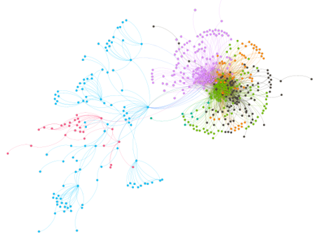
Examples of Assortativity

Slide 38
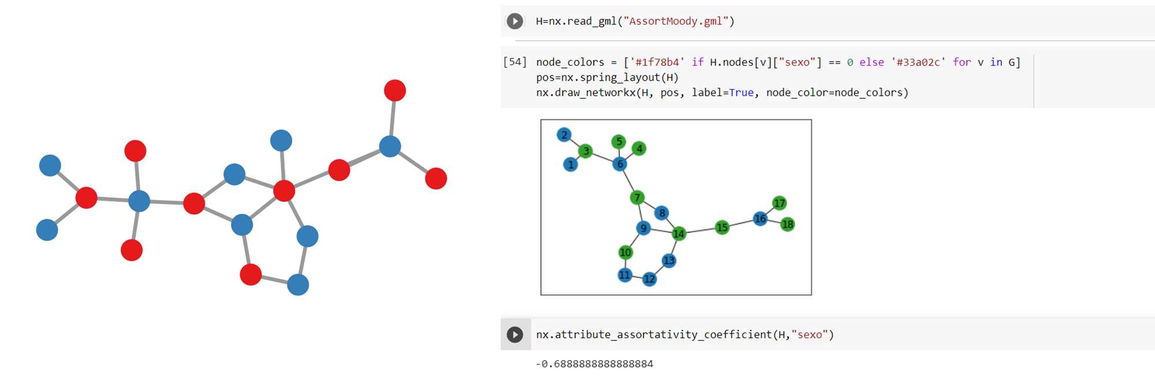
Sexual Partners

Slide 39
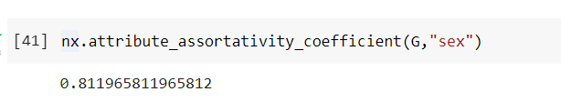
School Play-yard

Slide 40
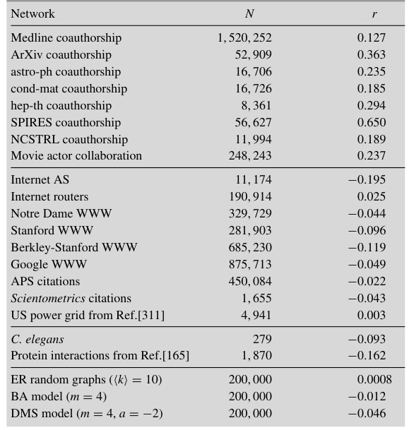
Tabla

Slide 41
Assortativity vs Disassortativity

Slide 42
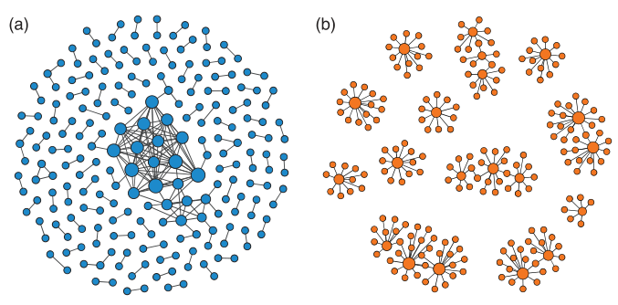
Assortativity Disassortativity

Slide 43
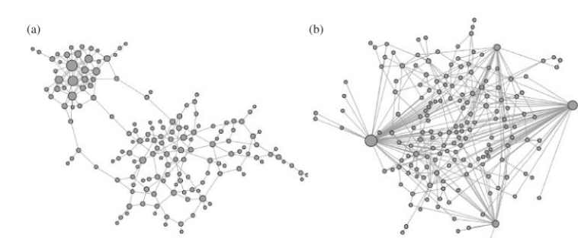
Assortativity Disassortativity

Slide 44
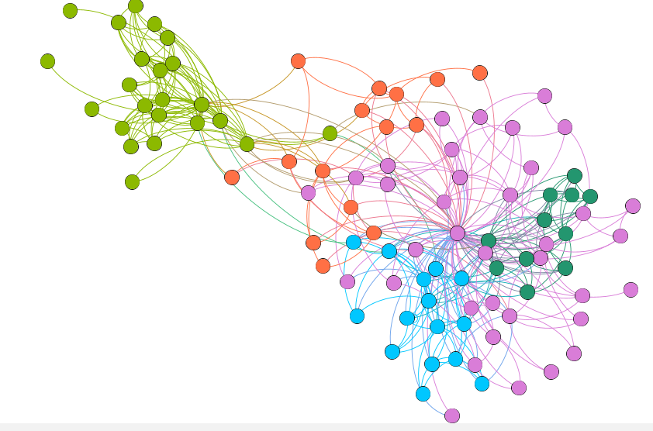
Degree Assortativity
Degree assortativity is a specific type of assortativity that measures the tendency of nodes in a network to connect with other nodes that have a similar number of connections (i.e., similar degree).

Slide 45
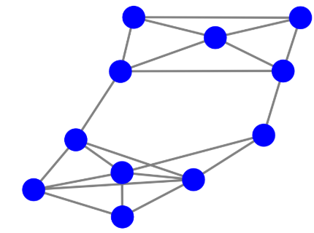
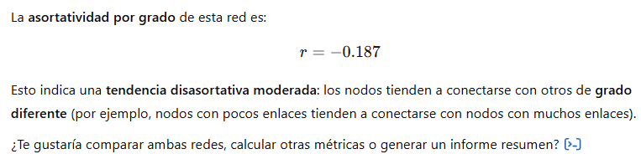
School Play-yard

Slide 46
Real Networks

Slide 47
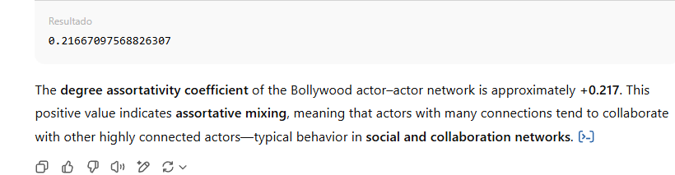
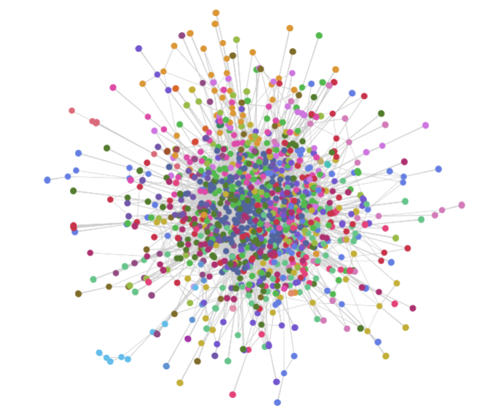
BolliWood Actors
Link to Model

Slide 48
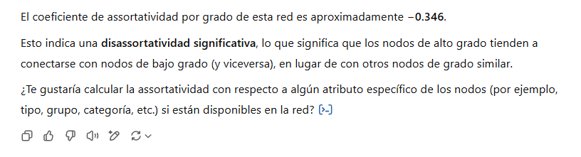
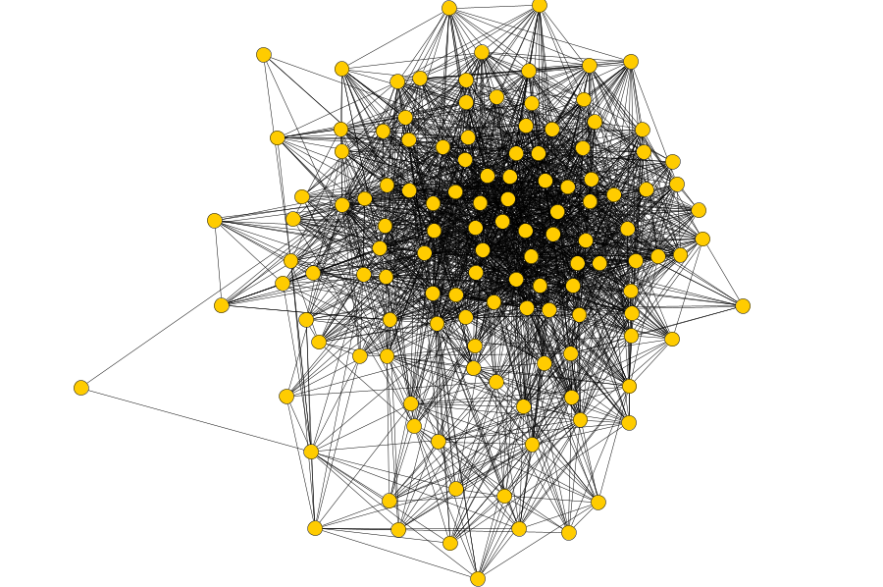
Florida Foodweb
Link to Model

Slide 49
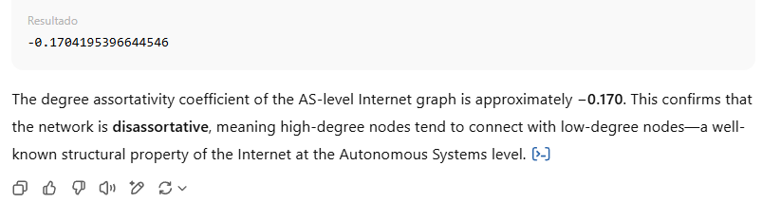

Internet Snapshot
Link to Model

Slide 50


Red FaceBook
Link to Model

Slide 51


US Flights
Link to Model

Slide 52


Celegans
Link to Model

Slide 53
Good bye

Slide 55
Credits
Subject Matter Expert
Instructional Designer
Jorge Alfonso Meléndez Acuña
Angela Maria Arboleda Restrepo
Subject Matter Expert
Graphic Designer
Luis Fernando Niño Vásquez
Tania Valentina Flórez Rincón
First version
Date: April 2025

